Slide 1




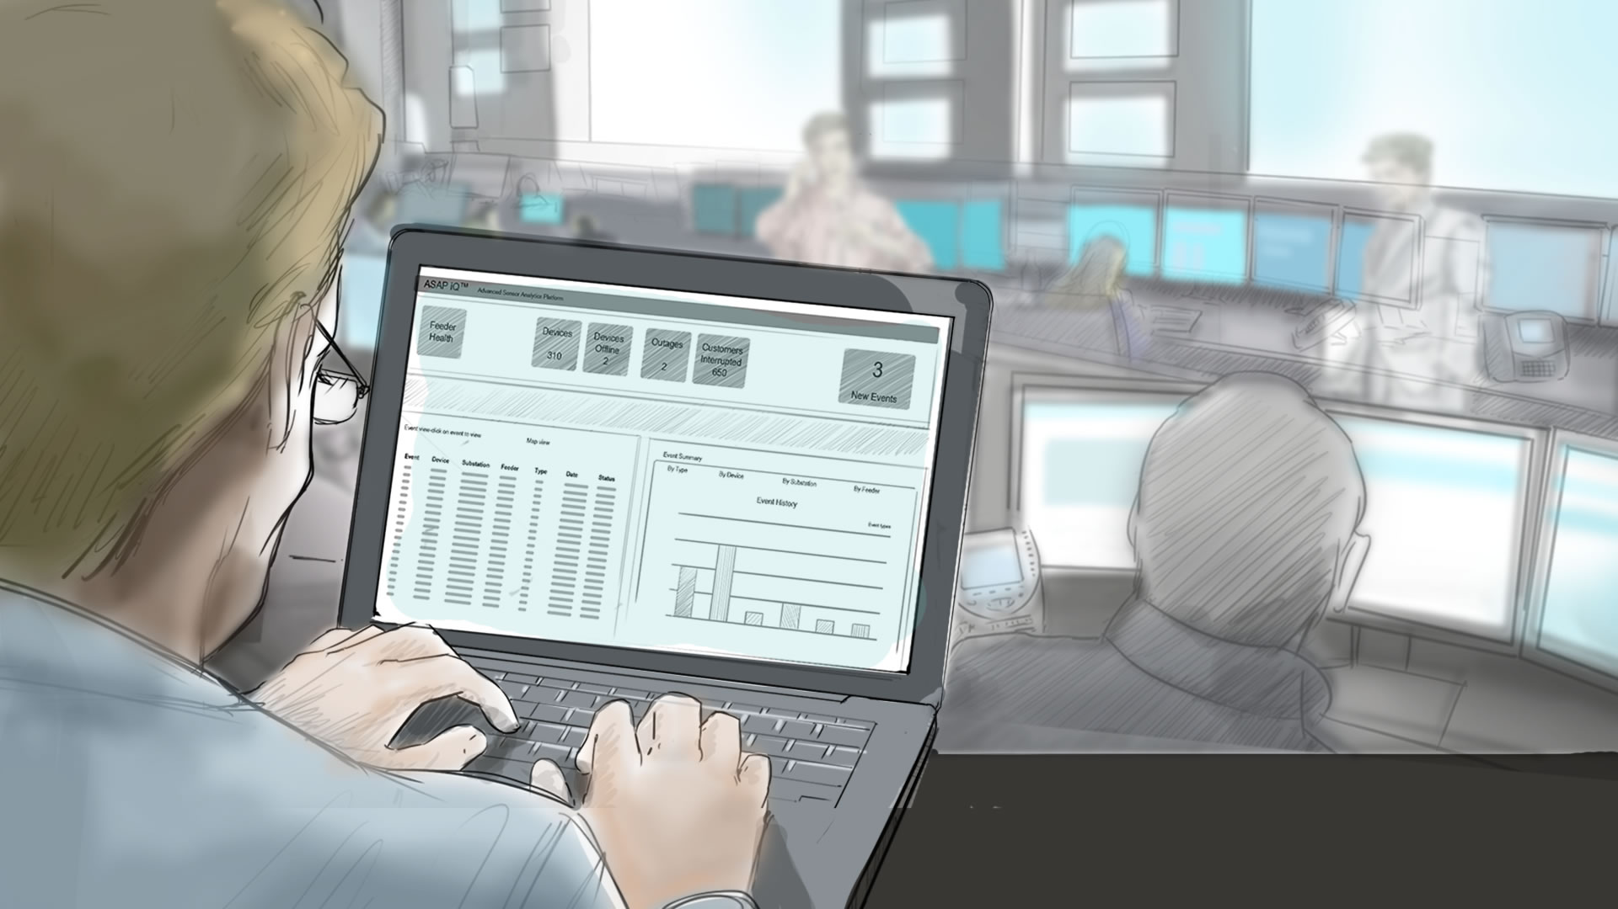





Notional Architecture
Autonomous
Mobile Cloud Enterprise
Database
Cloud Service
API Platform
Cloud Service
Intelligent Bots
Cloud Service
Steve Adams
Hack-a-Thon Participant
Node
REST API
John Henry
SnackBot Admin
React
Web App
React
Web App
Application
Container
Cloud Service
Notes:
.

Slide 2
North American Technology Division Solution Engineering Team
600
Oracle Public
Cloud Workshop
AppDev: Autonomous Mobile Cloud Enterprise Workshop

